Slide 1
Application Logger
Always log information to keep updates

Slide 2
Introduction
A Logger object is used to log messages for a specific system or application component. Main components are
Loggers : Responsible for capturing logging information.
Appender : Responsible for publishing logging information to various preferred destinations.
Layouts : Responsible for formatting logging information in different styles.

Slide 3
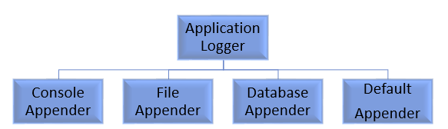
Logger Classes

Slide 4
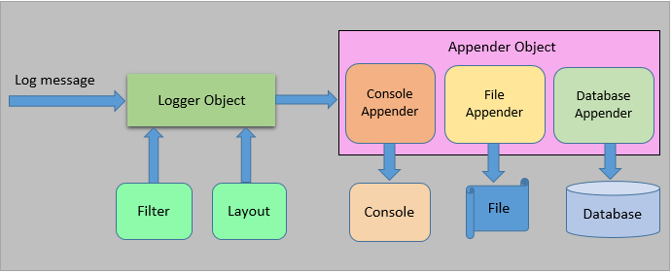
Architecture

Slide 5
Features
It is optimized for speed.
It manages file as we want. Create file name by present date time.
It supports multiple output Appender per logger.
It is designed to handle Java Exceptions from the start.
It uses multiple levels, namely ALL, TRACE, DEBUG, INFO, WARN, ERROR and FATAL.
The format of the log output can be easily changed by extending the Layout class.

Slide 6
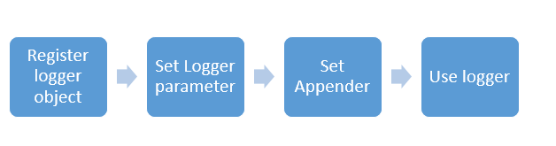
How can we use Logger

Slide 7
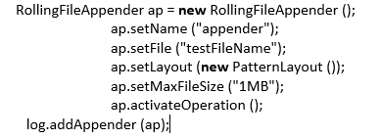
How can we use Logger
Step 1 : First import Log4j.jar and Application Logger Tool.jar.
Step 2 : Create a logger object.
Step3 : Create Appender Object then add into logger object.

Slide 8
Thanks

Slide 9
Queries ?

